Slide 1
Finance agent
Student name :Devang Deshmukh
College Name: MIT Academy of Engineering
Department: Electronics and Telecommunications.

Slide 2
OUTLINE
Problem Statement
Technology used
Wow factor
End users
Result
Conclusion
Git-hub Link
Future scope
IBM Certifications

Slide 3
Problem Statement
A significant portion of the population, especially in semi-urban and rural areas, lacks adequate understanding of digital financial tools, leading to poor financial decisions, vulnerability to scams, and underutilization of services like UPI and mobile banking. With the increasing digitization of financial services, this digital divide creates economic and social disadvantages.
Proposed Solution: An AI-powered Digital Financial Literacy Agent using RAG and IBM Cloud Lite services (including IBM Granite) to provide accurate, multilingual answers to users’ financial questions. It retrieves trusted content to educate users on UPI, interest rates, budgeting, and online safety—empowering them to use digital finance confidently and securely.

Slide 4
Technology used
IBM cloud lite services
Retrieval Augmented Generation (RAG)
IBM Granite model

Slide 5
IBM cloud services used
IBM Cloud Watsonx AI Studio
IBM Cloud Watsonx AI runtime
IBM Cloud Agent Lab
IBM Granite foundation model

Slide 6
Wow factors
Multilingual Support: Users can interact in their preferred language, making financial education more inclusive.
Trusted Content Retrieval: Information is pulled from verified government and banking sources, ensuring accuracy and reliability.
Personalized Financial Guidance: Tailored responses based on user queries—helps with UPI, budgeting, loans, scams, etc.
Fraud Protection: Educates users on common online scams and safe digital practices.
Voice & Text Interaction: Offers easy access for users with different literacy or accessibility needs.
Empowers Financial Independence: Builds user confidence in managing digital transactions.
Real-Time, Interactive Learning: Users get instant, conversational responses instead of reading through dense documents.
Culturally Inclusive: The agent respects regional preferences and norms, increasing engagement.

Slide 7
End users
General Public – Especially individuals in semi-urban and rural areas with limited financial knowledge
Senior Citizens – Who may need assistance understanding and using digital payment systems
Students and Young Adults – New to personal finance and digital banking
Low-Income Groups – Who are vulnerable to scams and financial mismanagement
Small Business Owners and Vendors – Who rely on UPI and digital payments for daily transactions
NGOs and Financial Literacy Campaigns – For use in workshops or community education programs
Regional Language Speakers – Who benefit from multilingual interaction and accessibility

Slide 8
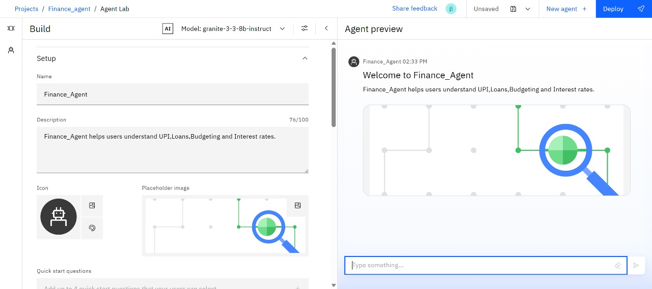
Results

Slide 9
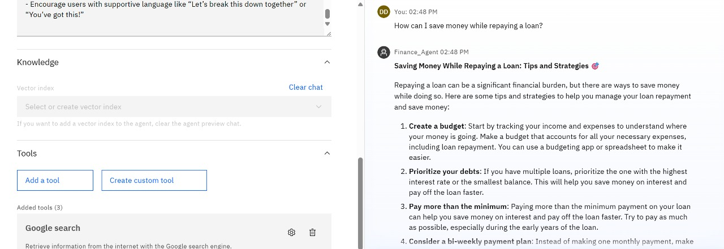
Results

Slide 10
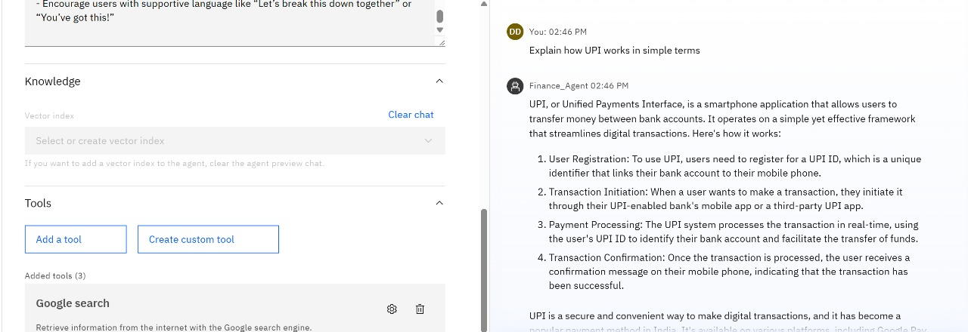
Results

Slide 11
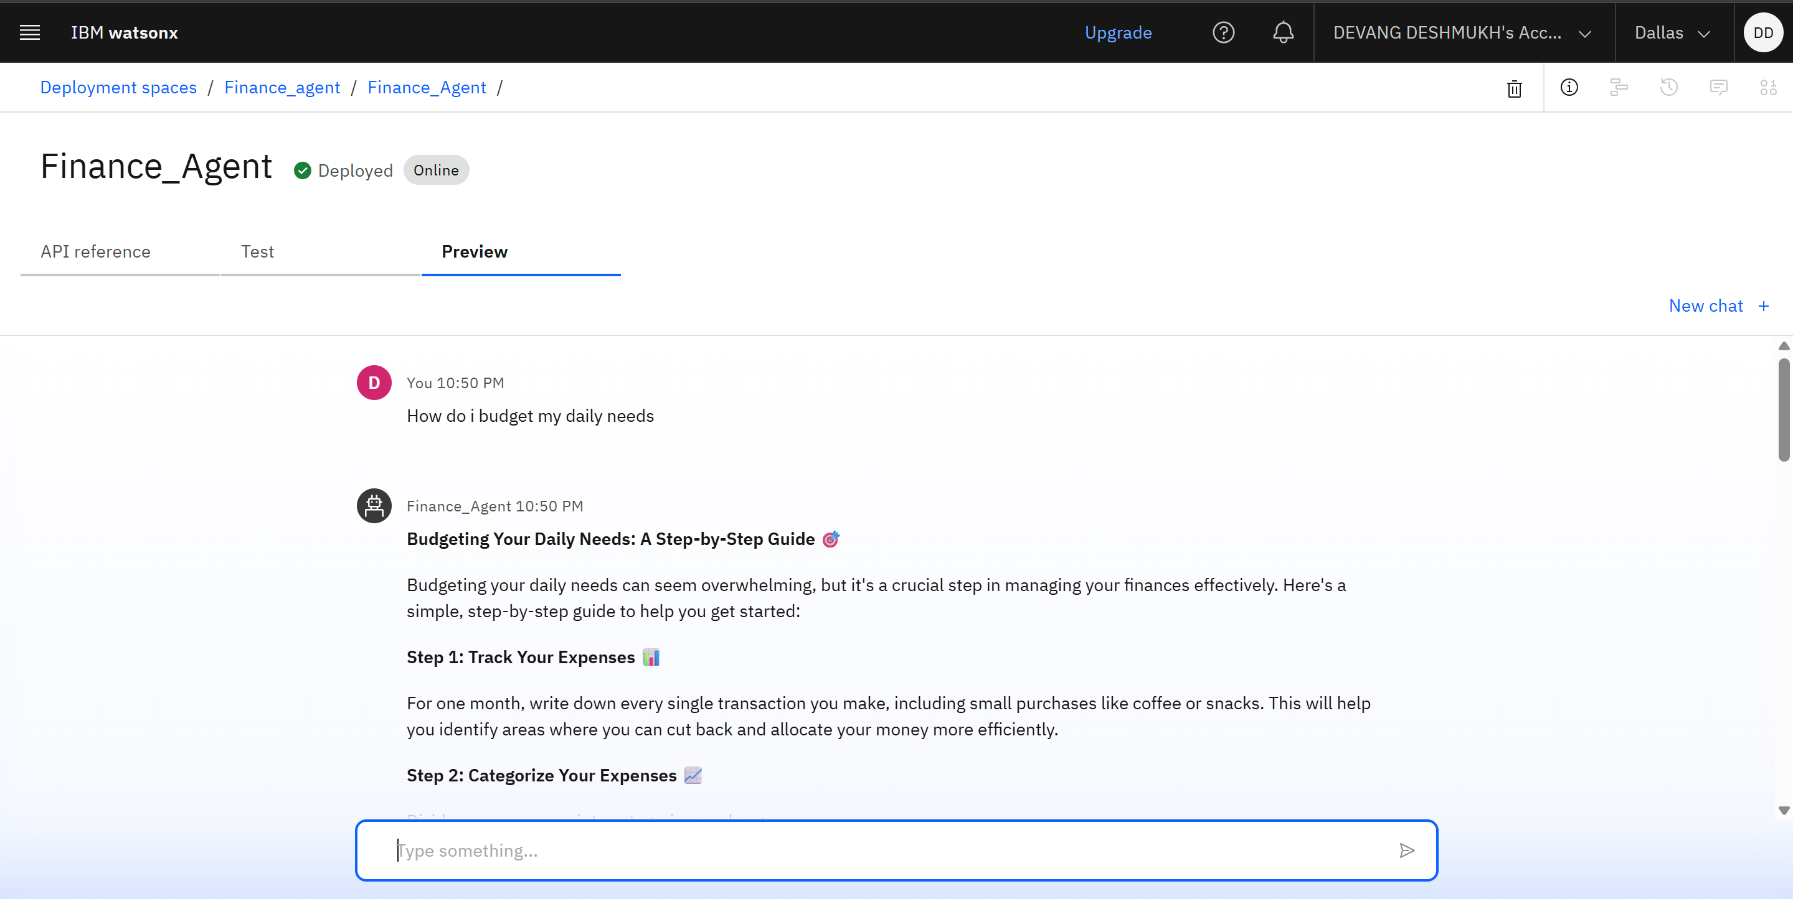
Results
Deployed AI Agent

Slide 12
Conclusion
Empowers users with clear, accurate financial knowledge
Reduces vulnerability to digital scams and fraud
Promotes responsible use of digital financial tools like UPI
Supports users in their preferred language, enhancing accessibility
Bridges the financial literacy gap, especially in underserved areas
Builds user confidence in managing personal finances digitally
Contributes to a more financially aware and inclusive society

Slide 13
Future scope
Integration with Voice Assistants: Enable hands-free access for illiterate or
visually impaired users
Support for Regional Government Schemes: Educate users about state-specific
financial benefits and subsidies
Gamified Learning Modules: Interactive games and quizzes to improve
engagement and retention
Offline Functionality: Extend support to areas with limited internet access via
SMS or USSD-based systems
Financial Goal Tracking: Help users set and monitor saving or budgeting goals
through the agent
Collaboration with Banks and NGOs: For wider outreach and customized content
delivery
User Behavior Analytics: Use AI insights to improve content personalization and
detect financial risk patterns

Slide 14
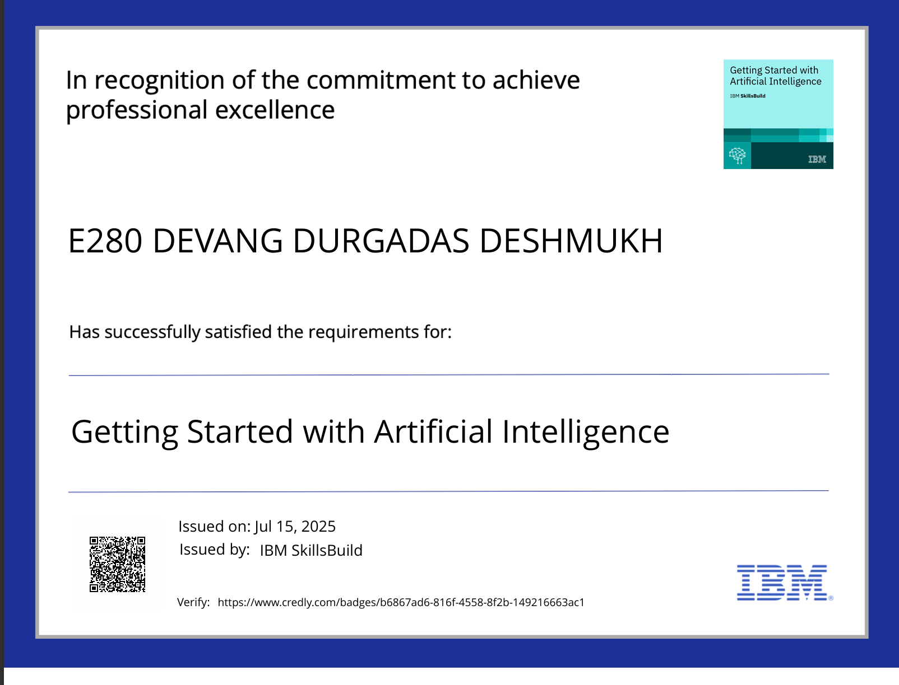
IBM Certifications

Slide 15
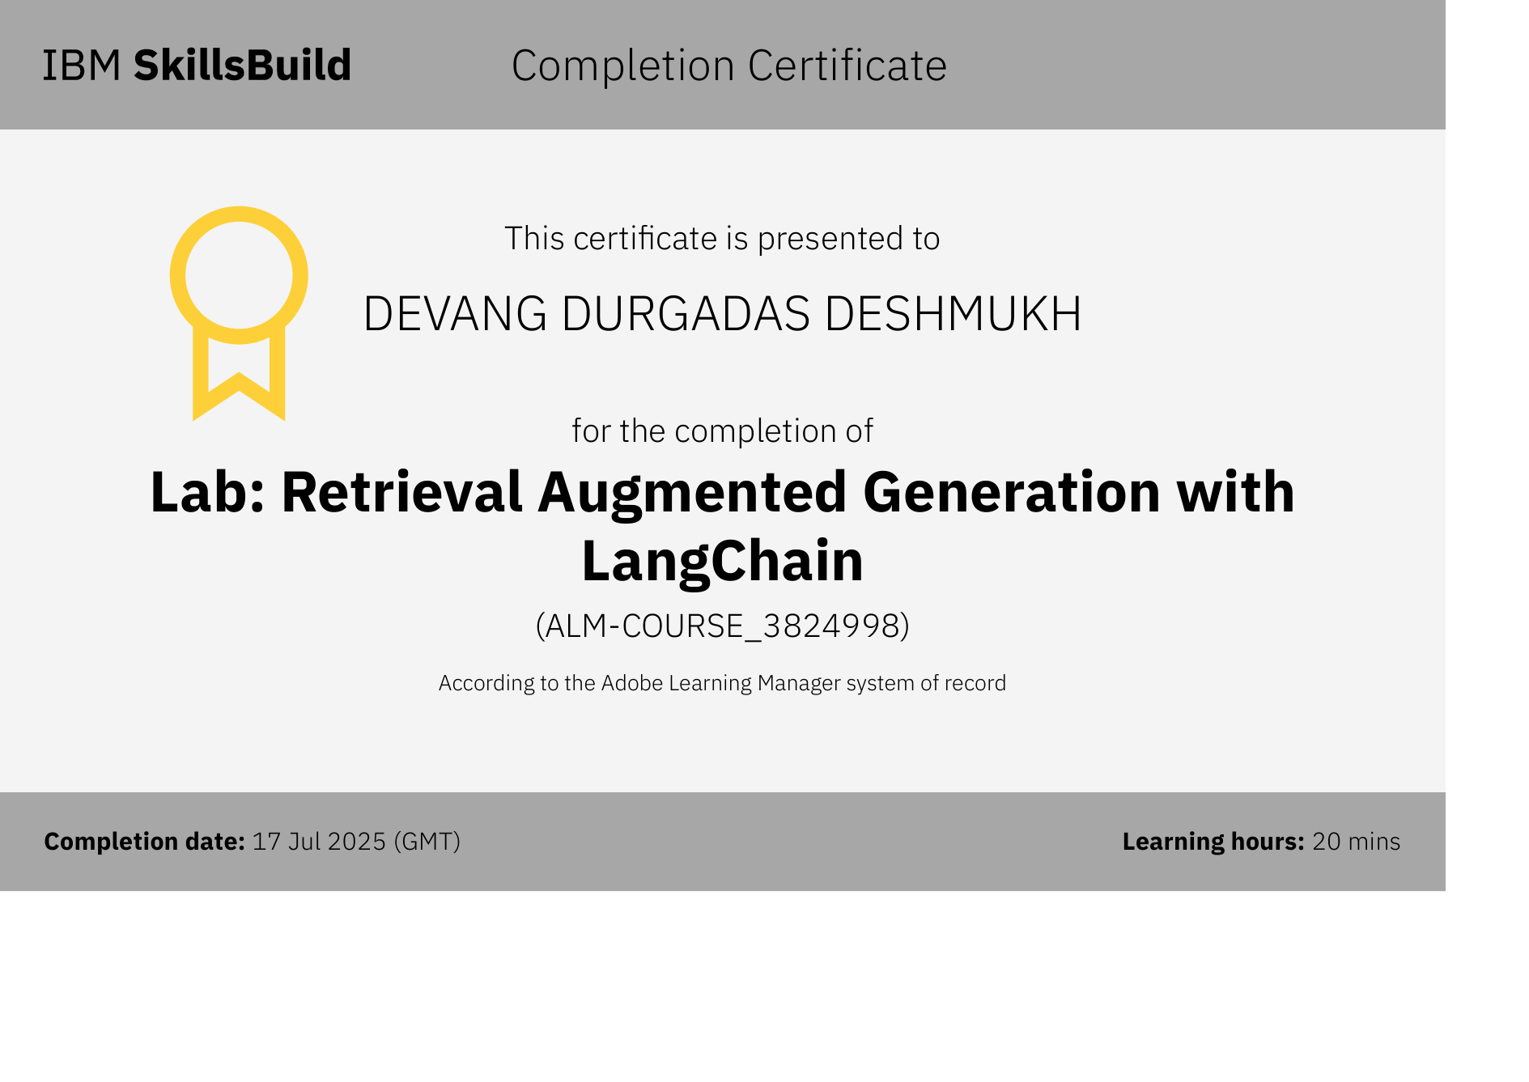
Rag Lab Certificate

Slide 16
Git hub link : https://github.com/DevangDeshmukh170/Finance_Agent

Slide 17
THANK YOU

